Slide 1
INTRA CANAL MEDICAMENTS

Slide 2


INTRA CANAL
MEDICAMENTS
LINE
OF
CONTROL
BACTERIA

Slide 3
Intra canal medicaments have traditionally gone hand in glove with endodontics.
Considered to be an integral part of the treatment
Tend to be effective against micro-organisms that may have resisted the root canal preparation

Slide 4
1800 – Beechwood cresote was recommended for root canal treatment
Richmomd – 1884 advocated , “knocking out the pulp “ by whittling down orange wood to a small size , soaking the stick in phenol & tapping this into the exposed pulp canal.
Phenol was added in an attempt to preserve & sterilize the contents of the canal

Slide 5
Definition
A chemical agent sealed within the root canal system; used between appointments as an anodyne and/or antimicrobial agent.
American Association of Endodontists

Slide 6
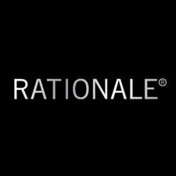
Destroy residual microorganisms and their toxins that have not been removed during canal preparation.
Anaerobic bacteria may invade the dentinal tubules of the canals with necrotic pulps.
The medicament should inhibit microbial re-colonization of the cleaned parts of the root canal system by preventing
residual microorganisms from growing
new microorganisms invading
through the lateral communication and coronal access.
Notes:
Though the objective of removing the microbes is mostly fulfilled during canal preparation but the complexity of the root canal is such that not all microorganisms or the pulp tissue are removed.

Slide 7
CLASSIFICATION

Slide 8
ACCORDING TO WALTON
1.Essential oils: Eugenol
2.Phenol/Phenolic compounds:
Parachorophenol , Camphorated parachlorophenol
Camphorated monoparachlorophenol , Creastin , Cresol
Creosote (Beechwood) , Thymol , N₂ compounds
3.Aldehydes: Formocresol , Glutaraldehye
4.Halides: Sodium hypochlorite , Iodine potassium iodide
5.Steroids
6.Calcium hydroxide
7.Antibiotics
8.Combinations

Slide 9
GROSSMAN CLASSIFICATION
Essential oils : Eugenol
2. Phenolic compound : Phenol , Parachlorophenol
Camphorated parachlorophenol , Formocresol
Glutaraldehyde , Cresatin , N2
3. Halogens
Sodium hypochlorite
Iodides
4. Quaternary Ammonium compounds
9 - amino acridine

Slide 10
ACCORDING TO INGLE
Classified antimicrobial agents broadly into 2 groups
1.Conventional antiseptics / Locally used antiseptic
2.Chemotherapeutics

Slide 11
Locally used antiseptics:
Alcohols
Ethyl alcohol
Isopropyl alcohol
2. Phenolic compounds
Phenol
Camphorated phenol
Monochlorophenol
Paramonochlorophenol
Thymol
Eugenol
Creosote

Slide 12
3. Heavy metal salts
Salts of silver, mercury, copper.
4. Cationic detergents
Quaternary ammonium compounds.
5. Halogens
Sodium hypochlorite
Potassium iodide, iodine

Slide 13
According to Franklin S Weine
Phenol and related compounds
eugenol
camphorated paramonochlorophenol
metacresylactate
cresol
thymol
PBSC
penicillin
bacitracin
streptomycin
caprylate
Sulphonamides
Corticosteroid- antibiotic combinations
Calcium hydroxide

Slide 14
IDEAL REQUIREMENTS
It should be an effective germicide and fungicide.
It should be non-irritating to the periapical tissues.
It should remain stable in solution.
It should have prolonged antimicrobial effect
It should be active in the presence of blood, serum and protein derivatives of tissues.
It should have low surface tension.
It should not interfere with repair of periapical tissues.
It should not stain tooth structure
It should not induce cell mediated immune response.
It should be capable of inactivation in a culture medium.

Slide 15
FUNCTIONS
Primary function
Anti Microbial Activity
Anti Sepsis
Disinfection

Slide 16
Asepsis
Is the assurance that no bacteria are present in the field of operation.
It involves the use of clean , sterile instruments and utensils, liquids.

Slide 17
ANTI SEPSIS
Antisepsis is the attempt to prevent or arrest the growth of microorganisms on living tissue.
In vital pulp extirpation, antiseptic measures are necessary to prevent infection in case there is a breach in the chain of asepsis.
Irrigating solutions and inter appointment dressings need to prevent or arrest the growth of microorganisms on living tissue.

Slide 18
Disinfection
Is the elimination of pathogenic microorganisms by chemical or physical means.
It involves
Mechanical removal of tissue and debris containing microbes.
Irrigation and dressing with antiseptic agents.
Surgical removal of an infected apex.

Slide 19
SECONDARY FUNCTION
Hard Tissue formation.
Pain Control.
Exudation Control.
Resorption Control.

Slide 20
Types of intra canal medicaments
Calcium hydroxide
Chlorhexidine digluconate
Antibiotic paste
Aldehydes – formocresol –

Slide 21
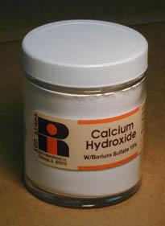
CALCIUM HYDROXIDE
1920 - Herman
Used - inter appointment intra canal disinfectant
pH of 12.5-12.8
Antibacterial, tissue dissolving and hygroscopic properties & forms a physical barrier to prevent bacterial
Increases the pH not only inside root canals but also in surrounding dentine and periradicular tissues
Best in weeping canals , where there is a constant clear / reddish exudate associated with large periapical lesion
Tooth - asymptomatic
Culture is usually –ve with no support of bacterial growth – calcium hydroxide – can be used

Slide 22
Best in weeping canals , where there is a constant clear / reddish exudate associated with large periapical lesion
Tooth will often be asymptomatic
Culture is usually –ve with no support of bacterial growth – calcium hydroxide – can be used

Slide 23
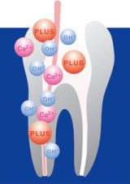
Antimicrobial activity
Release & diffusion of hydroxyl ions
Highly alkaline environment
Inhibit micro organisms growth

Slide 24
Used best in paste form - anticipates an excessive delay between appointments – efficacious – as long as it remains within the canal
also dissolve the pulp tissue & increases the efficacy of NaOCL

Slide 25
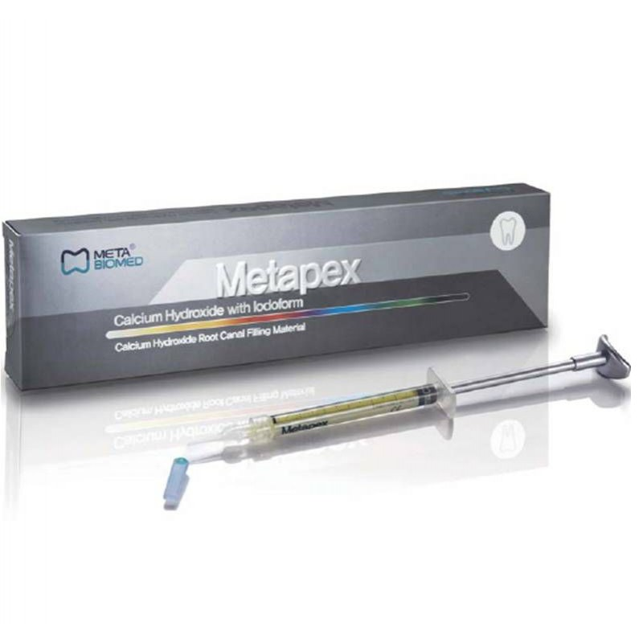
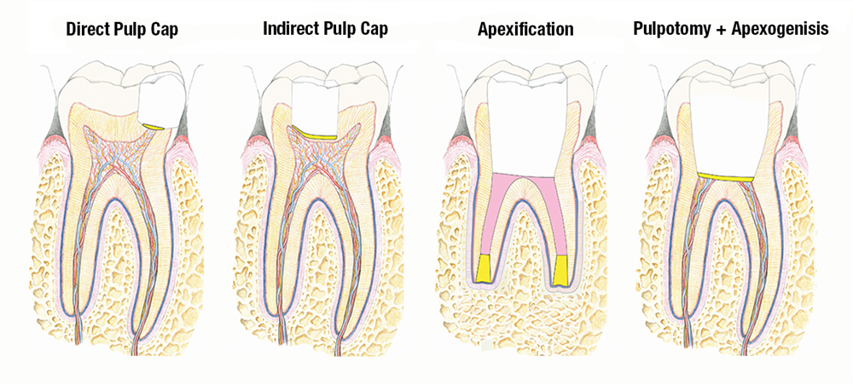
METAPEX
Premixed calcium hydroxide paste containing Iodoform with improved radiopacity and increased antimicrobial effect.
Indications:
Apexifications and hard tissue formations.
Temporary or permanent filling material for infected root canals.
Treatment of root resorption.
Perfect cavity liner under all filling material.
Can be used in conjunction with gutta percha points and regular root canal sealants.
Notes:
The superior antimicrobial effects of Metapex may be due to the combination with iodoform and to the viscous and oily vehicle, which may prolong the action of the medicament.

Slide 26
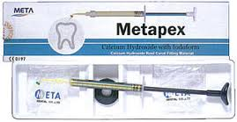
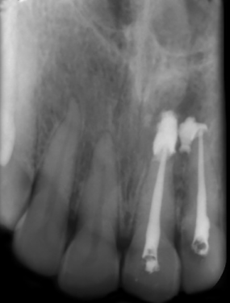
Composition:
Barium sulfate
Iodoform
Silicon oil and inert percipients
Product benefits:
Improved radiopacity & increased antimicrobial effect.
Non hardening paste with oil base.
Prolonged release of calcium hydroxide helps create secondary dentine.
Excellent bio-compatibility with no toxic effects on cells.
Easy handling and easy direct application.

Slide 27
Calcium hydroxide can be used as a powder with various vehicles
There are three types of vehicles used:
Aqueous
Viscous
Oily

Slide 28
Aqueous vehicles
Sterile water, distilled water, anesthetic solutions, ringer’s solution, methylcellulose, carboxy methylcellulose.
Viscous vehicles
Glycerine, polyethylene glycol, propyleneglycol.
(calen, calen+CMCP)
Oily vehicles
Olive oil, fatty acids, camphorated parachlorophenol, metacresylaceytate, eugenol.
(endoapex, vitapex)

Slide 29
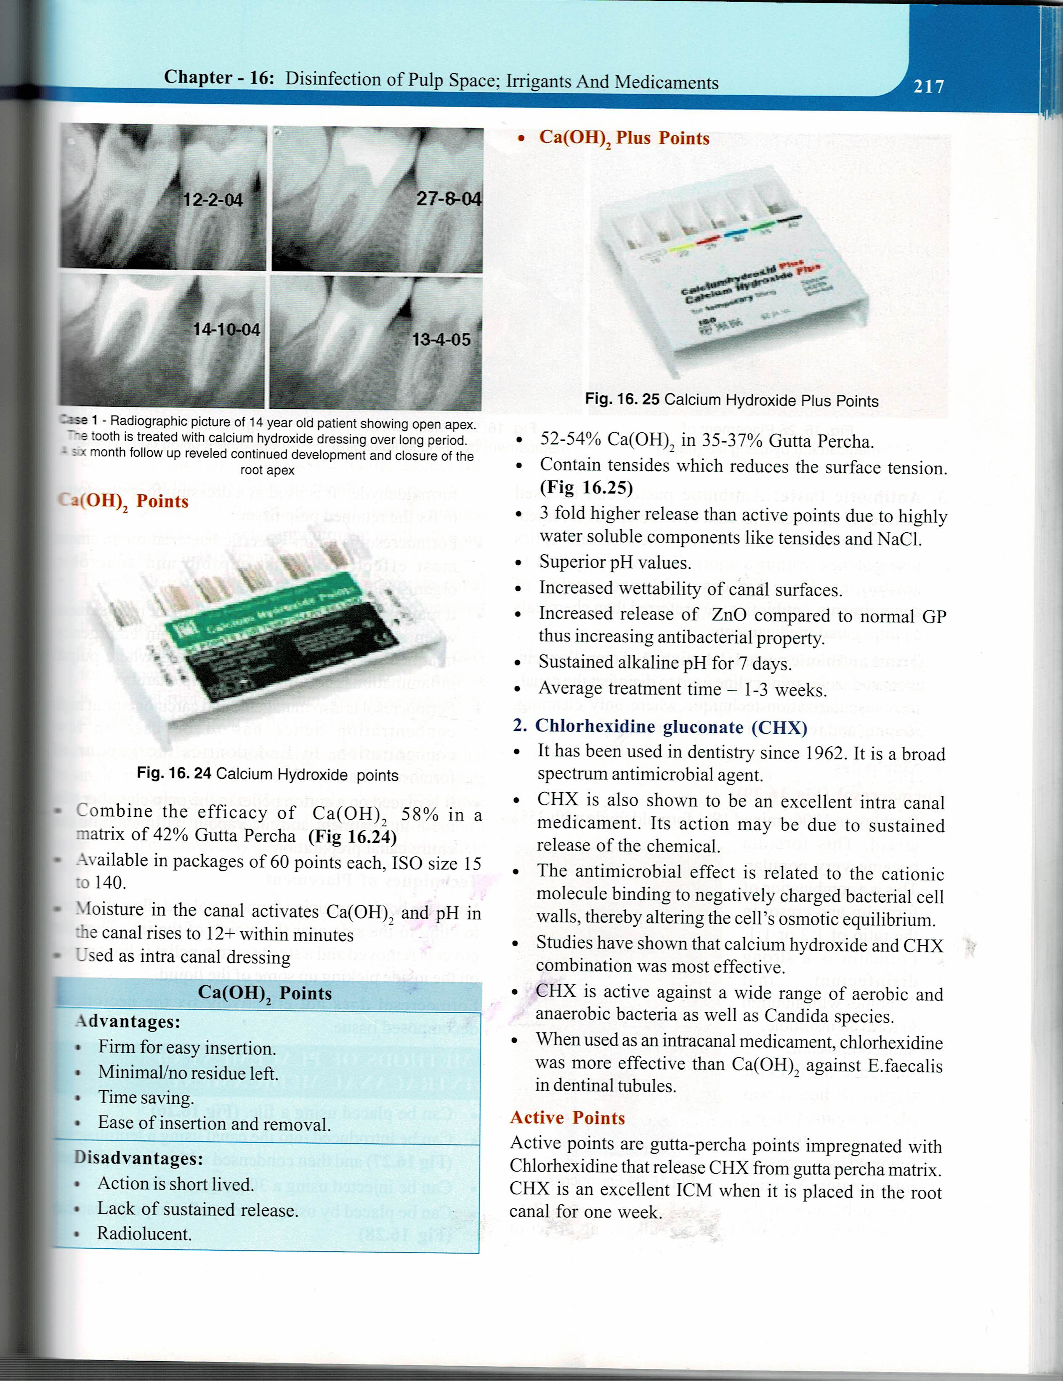

CALCIUM HYDROXIDE POINTS
Combine the efficacy of Ca(OH)2 58% in a matrix of 42 % GP
Available – 60 points each ISO size 15 to 140
Moisture in the canal activates Ca(OH)2 & pH in the rises to 12+ within minutes
Used as intra canal dressing

Slide 30
Ca(OH)2 PLUS POINTS
52.54 % Ca(OH)2 in 32-37% GP
Contains tensides – reduces – surface tension
3 fold higher release than active points due to highly water soluble components like tensides & NaCL
Superior pH values
Increased wettability of canal surfaces
Increased release of ZnO compared to normal GP - increasing antibacterial property
Superior pH values
Increased wettability of canal surfaces
Increased release of ZnO compared to normal GP thus increasing antibacterial property
Sustained alkaline pH for 7 days
Average treatment time – 1-3 weeks

Slide 31
CHLORHEXIDINE GLUCONATE (CHX)
1962 – use in dentistry
Board spectrum anti microbial agent
Action may be due to sustained release of the chemical
Antimicrobial effect is related to the cationic molecule binding to negatively charged bacterial cell wall- altering the cells osmotic equilibrium
Active against a wide range of Aerobic & Anerobic bacteria as well as Candida species.
Calcium hydroxide & CHX combination was found to be effective
When used as a intracanal medicament , CHX was more effective than Ca(OH)2 against e. faecelis in dential tubules

Slide 32
ACTIVE POINTS
GP points impregnated with chlorhexidine that releases CHX from GP matrix
CHX – excellent ICM – when placed in the root canal for one week

Slide 33
ANTIBIOTIC PASTES
Infection persists despite the use of antiseptic medication
Apical foramen has been inadvertently widened by over instrumentation and in an immature teeth with wide apical foramen.
Inter appointment time is more than 14 days
INDICATIONS
Notes:
Since they are less irritating to the periapical tissues compared to the chemical antiseptics, there is an argument for the use of paste where the apical foramen has been inadvertently widened by over instrumentation and in an immature teeth with wide apical foramen..
3. there is an evidence that the chemical antiseptics lose their potency faster in a canal as compared to antibiotics. Thus if the interappointment time is more than 14 days, the use of antibiotics is advantageous.

Slide 34
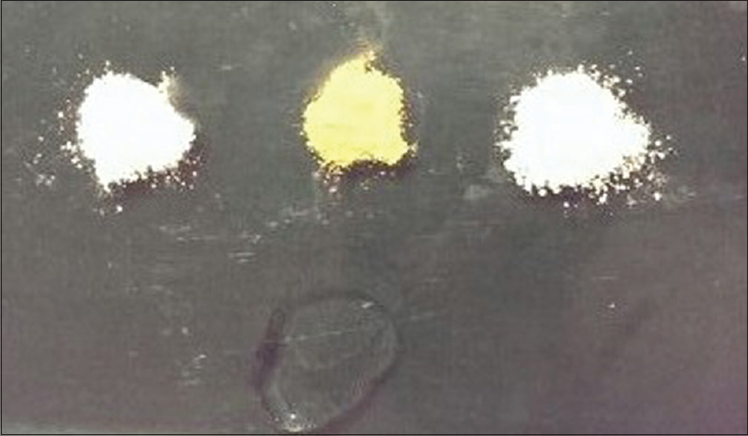
Triple Antibiotic Paste
Combination of three antibiotics - minocycline (100mg), ciprofloxacin (200mg), metronidazole (500mg).
Triple antibiotic powder, - mixed with normal saline / 2% chlorhexidine,
Concentrations used:
1:1:1 - Hoshino et al ,1996
1:3:3- Takushige T et al, 2004
Notes:
Commercial available as 3 Mix-MP….. Metronidazole - nitro imidazole compound; selectively toxic and effective against anaerobic organisms. Presence of redox protein reduces the nitro groups of this compound and generates free radicals that cause DNA damage and lysis of cell. Minocycline -bacteriostatic, inhibits protein synthesis by binding to 30S ribosome in susceptible organisms. Ciprofloxain -synthetic Fluoroquinolone with rapid bactericidal action. It inhibits the enzyme bacterial DNA gyrase

Slide 35
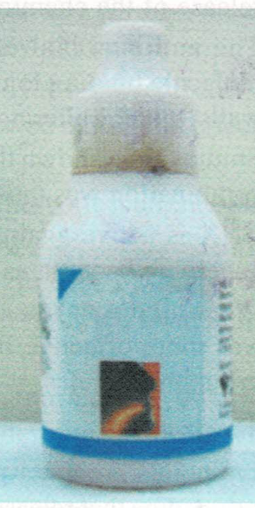
FORMOCRESOL
Buckley – 1906 - mixed 19% formaldehyde with 35% cresol
Formalin + cresol = 1:1 / 1: 2
Formalin is a strong disinfectant that combines with albumin to form an insoluble indecomposable substance & fixes the tissue
Low concentration is recommended - mutagenic & carcinogenic
Non – specific bacterial medicament effective against aerobic & anaerobic organisms
Used as a dressing for pulpotomy.
It is placed on a cotton pellet in the pulp chamber of the tooth in treatment & the vapor will penetrate the entire canal preparation

Slide 36
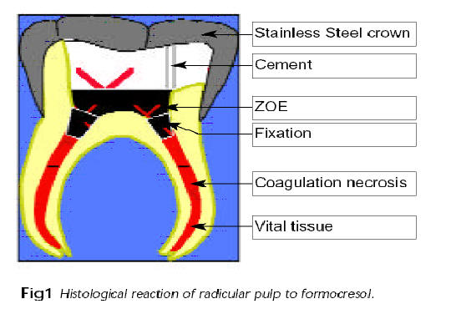

TECHNIQUES OF PLACEMENT
Invert the bottle containing formocresol allow the liquid to cling to the side near the mouth of the jar .
Then the cover is removed & a sterile cotton pellet is light wiped on the inside picking up some of the liquid
Formocresol does not effectively fix the necrotic / decomposed tissue

Slide 37

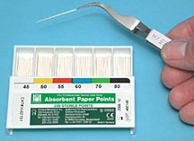

METHOD OF PLACEMENT OF INTRACANAL MEDICAMENT
Lentulo spiral
Paper point
Hand reamer

Slide 38

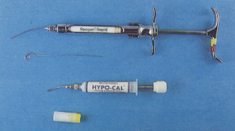

Cotton pellet – placing in pulp chamber
Injection with a syringe (30 gauge needle) followed by compaction with plugger,

Slide 39

LIMITATIONS OF INTRA CANAL MEDICATION
Intra canal environment
The therapeutic action of these medicaments depends on direct contact with the tissues
But – these may not reach all the areas – where bacteria / tissue present & have limited surface action
For these ICM to be effective – these should remain chemically active during the time of inter appointments .
Calcium hydroxide retains – antimicrobial action for a prolonged period
TOOTH
BACTERIA
ICM

Slide 40
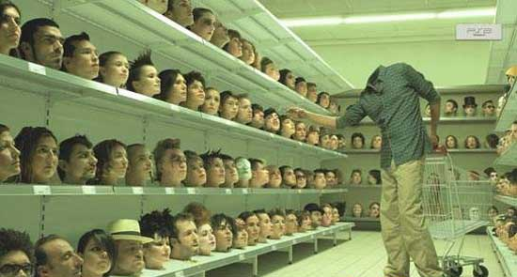
“At times we have a many options but we have to choose the best among them”

